Slide 1

Computer Security Assignment
All list of Symmetric ,Asymmetric and Hash algorithm function
NAME :CHALTUMAMO
ID: 512/11
SECTION : B

Slide 2
INTRODUCTION
WHAT IS CRYPTOGRAPHY?
Cryptography is the study of securing communication from outside observers. Encryption algorithms take the original message , or plaintext, and converts it into ciphertext ,which is not understandable . The key allows the user to decrypt the message , thus ensuring on they can read the message

Slide 3
Cryptography focuses on four different objectives
Confidentiality: Confidentiality ensures that only the intended recipient can decrypt the message and read its contents.
Non-repudiation: Non-repudiation means the sender of the message cannot backtrack in the future and deny their reasons for sending or creating the message

Slide 4
…continued
3.Integrity : Integrity focuses on the ability to be certain that the information contained within the message cannot be modified while in storage or transit.
4.Authenticity: Authenticity ensures the sender and recipient can verify each other’s identities and the destination of the message.

Slide 5
Types of cryptography
Cryptography can be broken down into three different types:
Symmetric cryptography
Asymmetric cryptography
Hash function cryptography

Slide 6
Symmetric cryptography
symmetric cryptography or secret key cryptography uses a single key to encrypt data and decrypt with the same key
symmetric cryptography can be used on both in-transit and at-rest data but commonly used at rest data.
If it gets out , you’ll need another key .
very fast to use

Slide 7
Example of symmetric key cryptography
Data Encryption standard ( DES)
Advanced Encryption standard (AES)
BLOWFISH
elliptic curve (EC)
3DES
Diffie-Hellman (DH)
RSA

Slide 8
DES
In 1977 the US government adopted the Data Encryption Standard. It became an ANSI standard in 1981. DES has been around (attacked) for a long time.
DES is a block cipher algorithm that uses a 56-bit key.
Goal of DES is to complete scramble the data and key so that every bit of cipher text depends on every bit of data and ever bit of key
DES is a strong algorithm, but today with the shorter encryption key, its usefulness is limited.

Slide 9
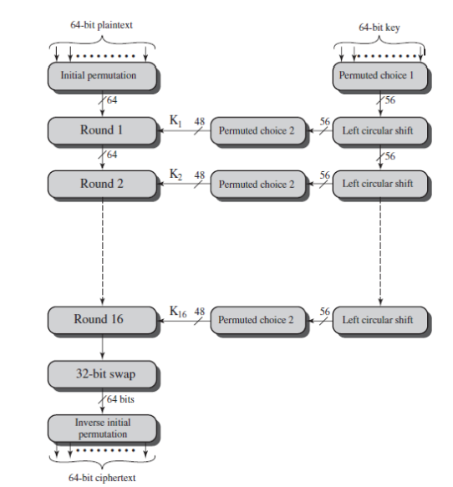
Figure 2. DES Encryption Algorithm

Slide 10
Triple Data Encryption Standard (3DES)
Triple-DES (3DES) is a method to make DES dramatically more secure by using the DES encryption algorithm three times with three different keys for a total key length of 168 bits.
The algorithm has been widely used by financial institutions and ssh

Slide 11
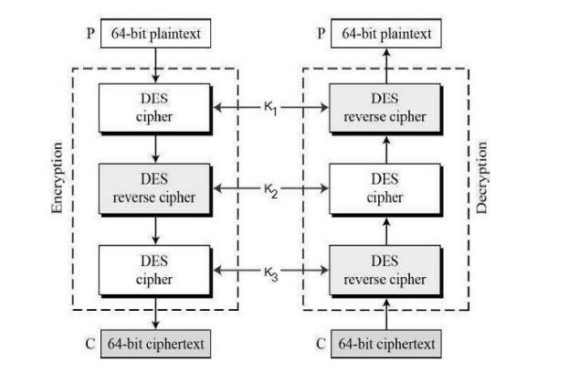
Figure DES Encryption Algorithm

Slide 12
Blowfish
Blowfish is fast, compact, and a simple block encryption algorithm published in 1993.
The algorithm allows a variable-length key, up to 448 bits, and is optimized for execution on 32 and 64 bit processors. The algorithm has been placed in the public domain and is also used in ssh.
Faster than DES and In operation, it splits messages into 64-bit blocks and individually encrypts them.

Slide 13
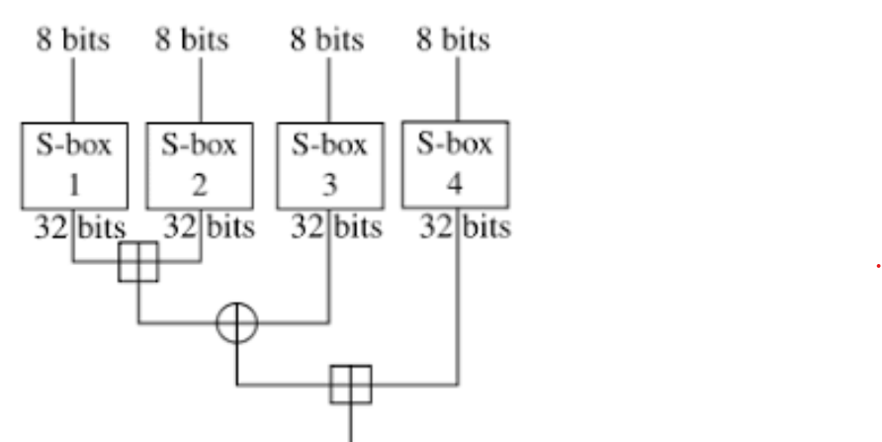
…continued
Figure 2. Blowfish Encryption Algorithm

Slide 14
Advanced Encryption Standard (AES)
This block cipher was developed by Daemen and Rijmem and was chosen in 2000 by NIST to be the new US Advanced Encryption Standard.
AES has effectively replaced DES in government circles. AES is an extraordinarily fast and compact cipher that can use keys that are 128, 192, and 256 bits long.

Slide 15
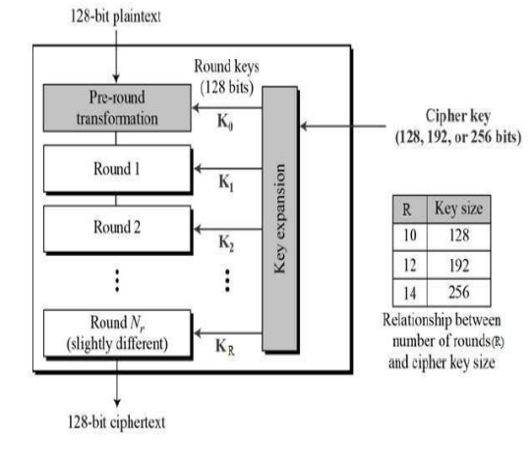
Figure 4. AES Encryption Algorithm

Slide 16
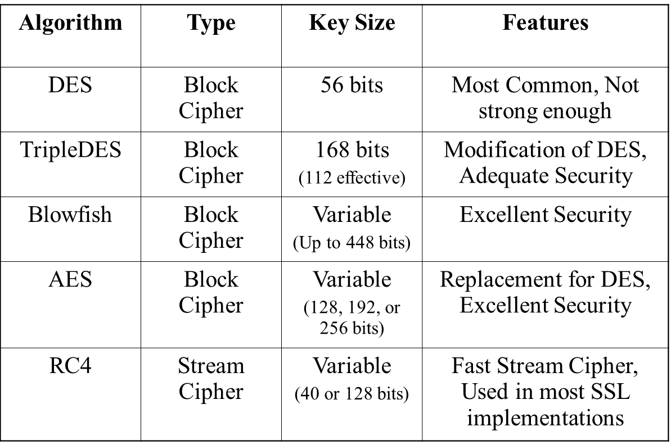
Summary of Encryption Algorithm

Slide 17
Advantages symmetric key cryptography
Symmetric key is faster than asymmetric key cryptography.
Same key Is used for encryption and decryption receiver cannot decrypt data without key (without sender permission).
Symmeteric key achieves the authentication principle because it checks receiver’s identity.
System resources are utilized in this cryptography.

Slide 18
Disadvantages symmetric key cryptography
Once key is stolen while transmitted data can easily decrypt.
In symmetric key cryptography , key is transmitted first and then message is transfer to the receiver .If attacker the communication, he can easily decrypt the message.

Slide 19
Asymmetric cryptography
Asymmetric cryptography is also known as public-key cryptography.
Asymmetric cryptography is one public key and one private key to encrypt and decrypt a message and protect it from unauthorized access or use.
Public-key is a cryptographic key that can be used by any person to encrypt a message so that it can only be decrypted by the intended recipient with their private key.

Slide 20
Example of Asymmetric key Cryptography
Rivesh Shamir Adlman (RSA)
Diffie Hellman Key exchange algorithm.
Digital Signature Standard(DSS)
Digital Signature Algorithm (DSA)
Elliptical curve cryptography (ECC)

Slide 21
Rivest-Shamir and Adleman (RSA)
RSA was invented by Ron Rivest, Adi Shamir and Leonard Adleman back in 1978.
It operate by using a variable key and encryption block. It uses block size data where plain text and cipher text are integrated between 0 and 1.
The main advantage of RSA is that it has enhanced security as compared to other algorithms.
Three steps are involved:
1 . generation of public/private key pair,
2. encrypting the plain text (data) into ciphertext (data), and
3. decrypting the data to generate the original text.

Slide 22
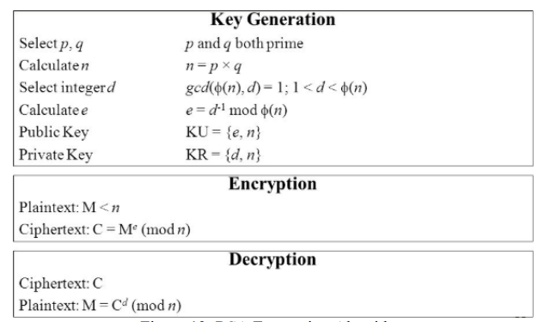
Figure . RSA Encryption Algorithm

Slide 23
Diffie-Hellman
This algorithm was established by Diffie-Hellman in 1976.
This algorithm is used to create a shared secret between two parties through a secured physical channel. Each of the parties comes up with a secret key that is only known to them.

Slide 24
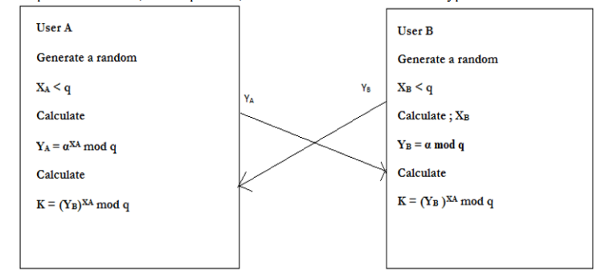
Figure . Diffie-Hellman Encryption Algorithm

Slide 25
Elliptic Curve Cryptography (ECC)
ECC is an asymmetric algorithm that utilizes varied keys to encode and decode.
ECC was based on the algebraic structure of elliptic curves over finite in limited domains.
ECC affords the ultimate security with the same bit sizes. It is good for battery backup, too since it consumes less energy
The main advantage of ECC is that its utilization of small key lengths which results in quick encoding and consuming minimal energy.

Slide 26
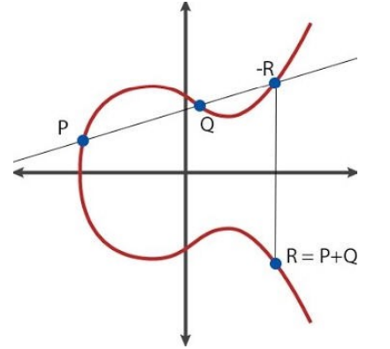
Figure 15. Basic Elliptic Curve Cryptography

Slide 27
Advantages of Asymmetric
If data is transmitting on insecure channel , but key cannot distributing among sender and receiver.
Separate key is used for encryption and decryption , even if encrypted message is stolen by attacker he/she cannot decrypt the message.
Easy to use for user.
Disadvantage
Asymmetric key use more resuorse in compare to symmetric key cryptography.
More mathematical calculation required
Slower in compare to symmetric key cryptography.

Slide 28
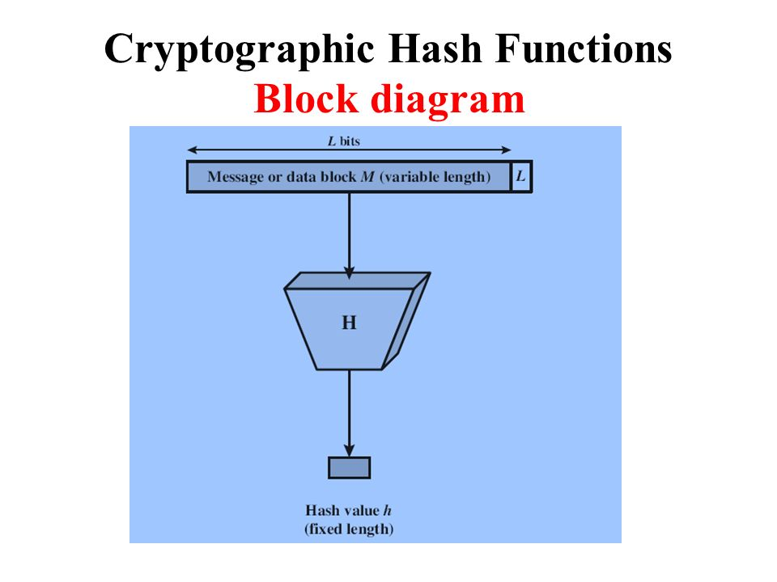
Hash function cryptography
In hash function H accepts a variable length block of input data called as ‘M’ and produce the fixed size hash value can be represented as
h=H(M)

Slide 29
Hash function protects the integrity of the message . If encryption process is apply on message with hash function, it is provide authentication and confidentiality.
A hash function provides a property that has function applied on variable amount of data (M) and then it produces the fixed amount of output data.
If any bit or bits changes in the data, then whole hash function output data will also changes.
Cryptographic has function is one –way function which is practically infeasible to invert.

Slide 30
Properties of hash function
Compression : as per compression properties output of hash function is much smaller than the size of input.
Pre-image resistance: pre-image resistance means difficult to find the input from given hash function output . i .e x=(H), so if x is given , it is difficult to message m.

Slide 31
…continued
Weak collision resistance: Given message m1, weak collision resistance means that it is difficult to produce another message m2 such that H(m1)=H(m2) i.e it means infeasible to find two different messages with the same hash value .
Strong collision resistance: means that is difficult to find any two different messages that hash to the same value.i.e it is hard to find m1 &m2 such that same hash value H(m1)=H(M2).

Slide 32
Characteristics of Hash function
It is quick to calculate hash value (h) for any given message i.e x= H(m)
Hash function (H) can be applied to variable length of data block.
A small change in message should change the hash value .
hash function has one-way property , it is impossible to generate message from given hash value .
The hash function uses all the input data.

Slide 33
The hash function “uniformly” distributes the data across the entire set of possible values.
The hash function generates very different hash value for similar values.
Here ,there are two simple hash function , all hash function are operating using same principle .
The messages file is like a simple input open a sequence on n –bit blocks.
When input is processed only one block at the given time in iterative fashion to generate an n-bit function

Slide 34
Advantages & Disadvantage of Hash function
Advantage
Main advantage is synchronization .
It is more efficient than search trees or any other table lookup structure .
Disadvantages
Hash collisions are practically unavoidable .when hashing a random subset.
Become quite inefficient when there are many collisions.
Does not allow null values , like hash map

Slide 35
Example of hash function cryptographic
MD5
SHA-1,
SHA-2,
NTLM, and LANMAN

Slide 36
MD5
This hash algorithm used to be widely used and is still one of the most widely known hashing algorithms
When MD5 is used to hash passwords directly, there is an even easier way to break it... Google.
By typing the hash in the search box, there's a good chance you'll receive its before-state within milliseconds
It was accepted for many years, but it’s now mainly used for verifying data against unintentional corruption.

Slide 37
SHA-family
Secure Hash Algorithm is a cryptographic hash function designed by the United States’ NSA.
SHA-0 (published in 1993) has been compromised many years ago.
SHA-1 (1995) produces a 160-bit (20-byte) hash value. It’s typically rendered as a 40 digits long hexadecimal number.
The big three – Microsoft, Google, and Mozilla — have stopped accepting SHA-1 SSL certificates in 2017 on their browsers
SHA-2 is Safer, for now. SHA-2 includes several important changes.

Slide 38
SHA-2 shares the same structure and mathematical operations as its predecessor (SHA-1)
SHA-3 (Secure Hash Algorithm 3)
A key aspect of SHA-3 is that it was designed to easily replace SHA-2 in applications that currently use that variant.
SHA-3’s have proposed additional features like an authenticated encryption system and a tree hashing scheme, but they aren’t standardized yet. Still, it’s the safest hashing algorithm for now.
In order to keep your security standards, you must always follow the newest technologies, especially when you use hashing algorithms for security.

